Slide 1
Lecture 2
DISPLAY DEVICES

Slide 2
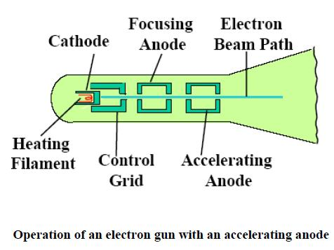

Slide 3
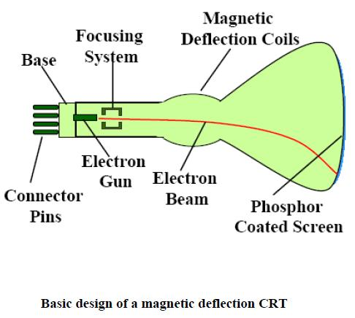

Slide 4
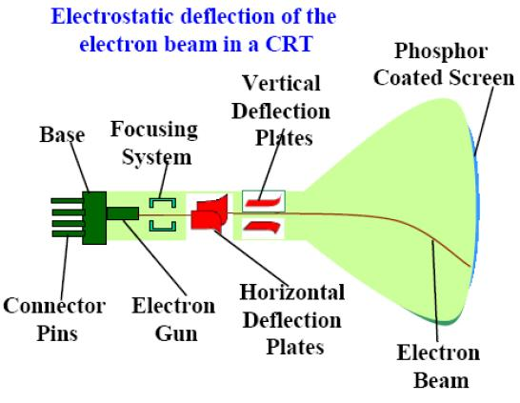

Slide 5
Working of CRT
The operation of CRT is very simple −
The electron gun emits a beam of electrons .
The electron beam passes through focusing and deflection systems that direct it towards specified positions on the phosphor-coated screen.
When the beam hits the screen, the phosphor emits a small spot of light at each position contacted by the electron beam.
It redraws the picture by directing the electron beam back over the same screen points quickly.
https://youtu.be/zj91VO7WJgU

Slide 6
There are various types of CRT Display Devices
DVST(Direct View Storage Tubes)
Calligraphic or Random Scan Display
Refresh and Raster Scan Display

Slide 7
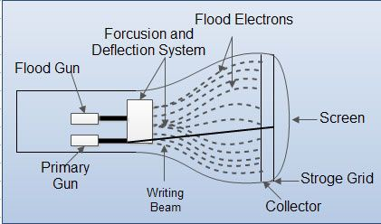
Direct View Storage Tube

Slide 8
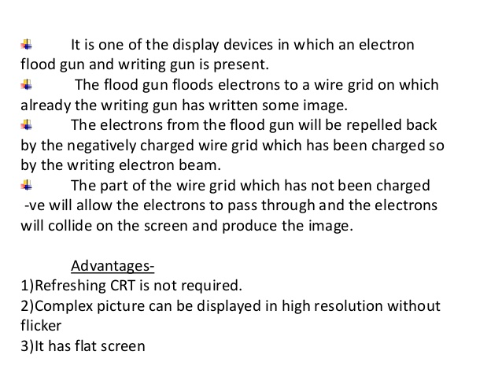

Slide 9
Drawbacks of DVST
Modifying any part of the image requires redrawing.
Change in the image requires to generate a new charge distribution in the DVST
Slow process of drawing
Erasing takes about 0.5 seconds
No animation is possible.

Slide 10
Applications of cathode ray tube
The cathode ray tube is used to create a moving image.
The CRT TV works by moving the electron beam scan the screen at a faster rate.
It is used in the cathode ray oscilloscope.
It is used as a display device in radar.
It is used in computer monitors and some television.

Slide 11
Conclusion
In this class we studied about the Cathode Ray Tube, it’s various parts and their working and various terminologies related to it. Also the concepts of DVST .

Slide 12
Questions
Very Short Questions(2 marks each)
Q.1. What is the use of anti-aliasing in certain graphic programs.
Q.2. How much frame buffer is needed for a 1280 by 1024 screen with 24-bit color.
Q.3. Which colors are not used to generate the color on a colored monitor?
Q.4. What is the smallest visual element on a video monitor?
Q.6. What is refresh rate?
Q.7. What is resolution?
Q.8. What do you mean by horizontal retrace and vertical retrace?

Slide 13
Short Questions (8 Marks)
Q.1. Write short note on: Anti-aliasing technique? (RTU 2014)
Q.2 Given the display screen of resolution 640×480 with the refresh rate of 60 frames /second. Compute access time per pixel. (RTU 2011)
Q.3. The display area of video monitor is given as 12"×9.6". If resolution is 1280×1024. What is the diameter of each pixel (aspect ratio=1)? (RTU 2012)
Q.4. How long would it take to load a 640 by 480 frame buffer with 12 bits per pixel, if 10⁵ bits can be transferred per second? (RTU 2013)
Q.5. A screen has 1024 scan lines with aspect ratio 4:3 and but depth 24, what is resolution of the screen and size of the frame buffer. (RTU 2014,18)
Q.6. What is frame buffer? Calculate size of frame buffer for a display device supporting true colors and has pixels on the screen. If size of screen is 9” X12” then calculate resolution and aspect ratio. (RTU2015)

Slide 14
Long Questions(15 Marks)
Q.1. Explain the following terms in context of display devices: (RTU 2016)
Resolution
Flickering
Interlacing
Refreshing
If a TV screen has 525 scan lines and an aspect ratio of 3:4 and if each pixel contains 12 bits intensity information, how many bits are required for refresh rate 30 frame per frames per second? (RTU 2017)
Explain in detail the working of Display Processor with the help of block diagram.

Slide 15


